Slide 1
Bootcamp 2023: Preprocessing Annotations
bayram

Slide 2
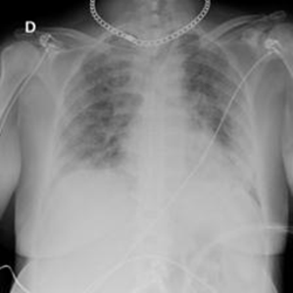
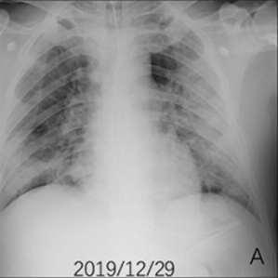
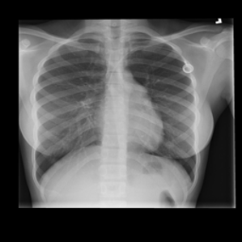
Introduction
Images come from machines
Some parts may not be relevant to research
Preprocessing
Deal with machine marks, foreign objects, incoherent geometry, etc
Remove surrounding tissue and organs from being sent to the algorithm.
kaggle.com/datasets/preetviradiya/covid19-radiography-dataset

Slide 3
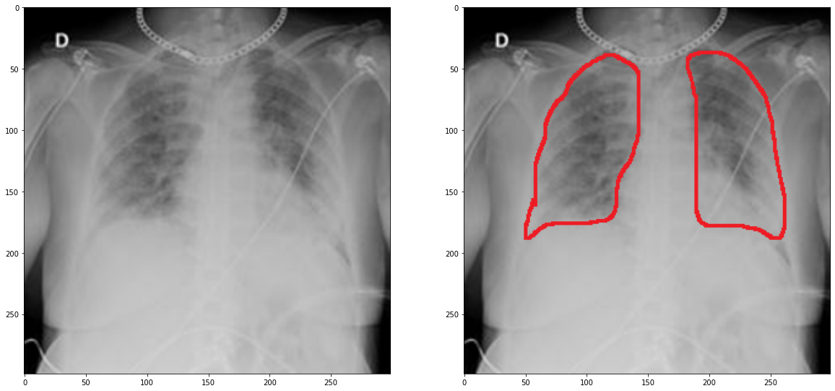
Human Annotation
MDs provide insight on the Region of Interest (ROI)
Paint (pro: widely available),
ImageScope (pro: less memory req’s, easier processing by *you-the-pythonista*)

Slide 4
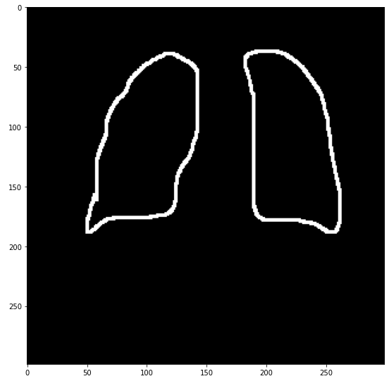
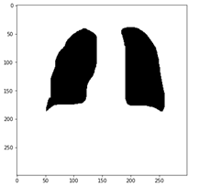
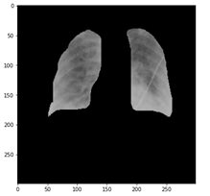
Working with annotations
Differentiating
CV/Graphics methods:
Dilation
Floodfilling
Negation
Masking

Slide 5
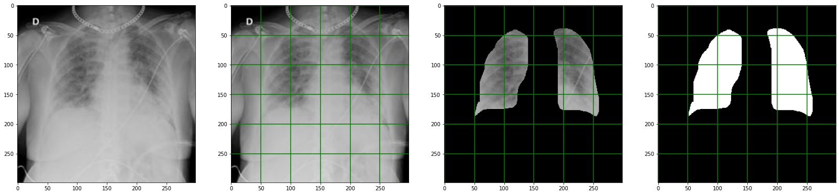
Data for the algorithm
Large images may require partition
Use the partition of the masked image
The mask plays important role
Save your every output!!

Slide 6
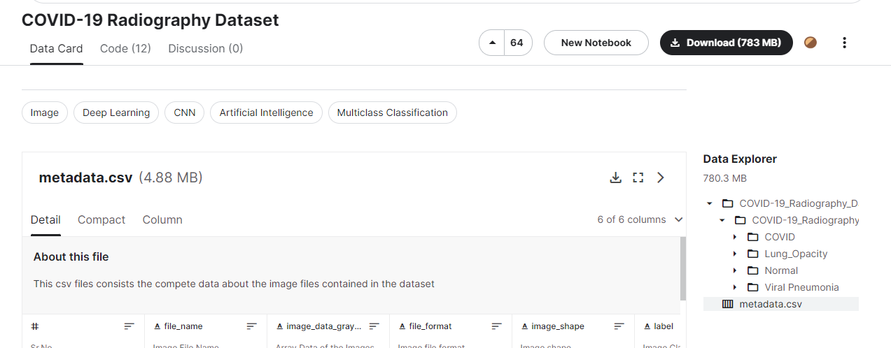
Hands-on
Dataset: kaggle.com/datasets/preetviradiya/covid19-radiography-dataset
X-rays of lungs: Normal (Healthy), Covid, etc
Download
N images from Normal
N images from COVID
N < 5 for today
Organize images
Produce annotations
Follow the me in Jupyter

Slide 7
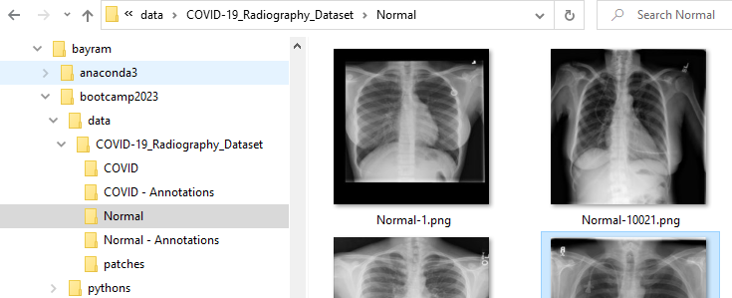
Hands-on
Dataset: kaggle.com/datasets/preetviradiya/covid19-radiography-dataset
X-rays of lungs: Normal (Healthy), Covid, etc
Download
N images from Normal
N images from COVID
N < 5 for today
Organize images
Produce annotations
Follow the me in Jupyter

